Slide 1

FUNDAMENTAL OF DATASCIENCE
A DIVE INTO MOVIE ANALYTICS
FOCUS ON KEY INSIGHTS

Slide 2

LEARNING OBJECTIVE
LEARNING OBJECTIVE
The objective of this presentation is to explore the key factors that influence the success of movies using data-driven insights. Through the analysis of movie budgets, box office earnings, IMDb ratings, and genres, the presentation aims to identify patterns and relationships that contribute to a movie's financial and critical success.
Conduct a short research project to answer a question, drawing on several sources and generating additional related, focused questions that allow for multiple avenues of exploration.

Slide 3
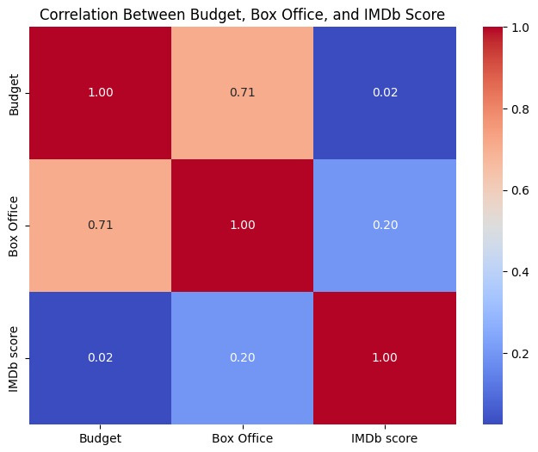
CORRELATION BETWEEN BUDGET, BOX OFFICE, AND IMDB SCORE
•We found a strong correlation between budget and box office revenue, indicating that higher-budget movies tend to generate more revenue. However, the relationship between IMDb scores and box office earnings is weaker, suggesting that audience ratings have some influence but are not decisive.

Slide 4
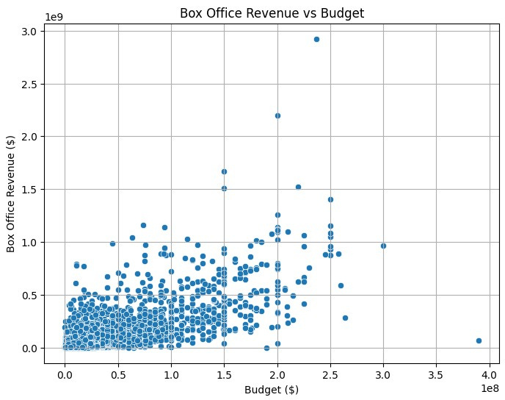

BOX OFFICE VS BUDGET
•A scatter plot analysis between box office revenue and budget reveals a positive relationship. While higher-budget films generally perform better at the box office, some low-budget films have achieved significant success, indicating that budget is not the only determining factor.

Slide 5
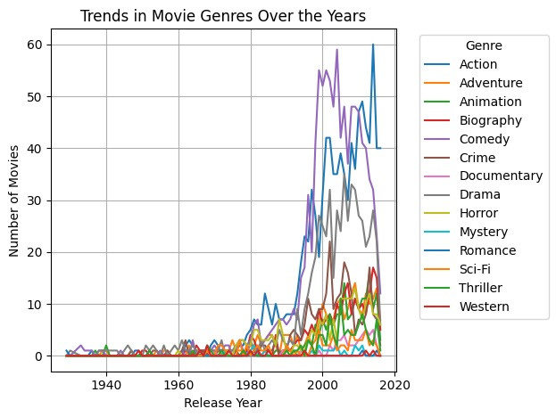
TRENDS IN MOVIE GENRES OVER TIME
•An analysis of genre trends over the years shows shifts in audience preferences. Action and superhero genres have seen a significant rise, while traditional genres like drama and romance have fluctuated. Understanding these trends can help industry professionals predict future demand.

Slide 6
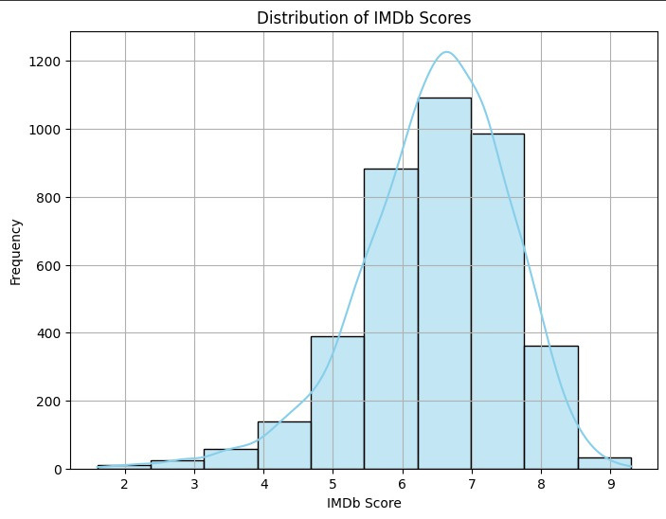
IMDB SCORE DISTRIBUTION
•The distribution of IMDb scores reveals that most movies tend to receive moderate ratings, with very few reaching exceptionally high scores. This distribution shows the competitive nature of receiving top ratings in the industry.

Slide 7
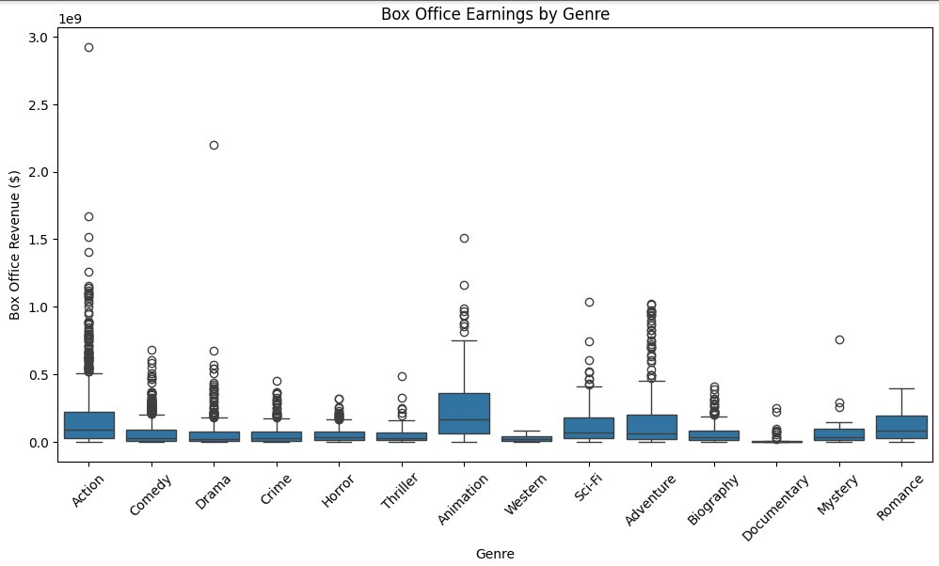
ANALYSIS OF BOX OFFICE EARNINGS BY GENRE
Action and Adventure films generally have the highest box office earnings, with numerous outliers exceeding $1 billion in revenue. These genres tend to feature blockbuster franchises that perform exceptionally well financially.
Animation films also demonstrate strong performance, with several instances surpassing $1 billion. This reflects the high profitability of animated family movies, particularly those produced by major studios like Disney and Pixar.
Drama, Comedy, and Horror have more moderate box office earnings, with fewer extreme outliers. Although they are popular genres, their financial success is typically lower compared to action and animation.
Genres like Documentary, Biography, and Mystery tend to generate lower box office returns. These genres may cater to more niche audiences, resulting in fewer films achieving blockbuster status.
3

Slide 8

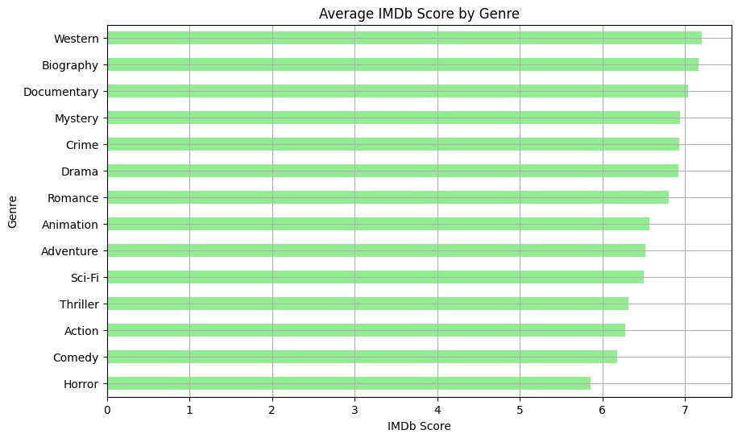
ANALYSIS OF AVERAGE IMDB SCORE BY GENRE
This horizontal bar chart shows the average IMDb scores for movies categorized by genre. Key observations are:
Western, Biography, and Documentary genres have the highest average IMDb ratings, indicating that these genres tend to receive more favorable reviews from viewers. These films often emphasize storytelling, character development, or real-life inspiration, which might appeal to critics and discerning audiences.
Genres like Mystery, Crime, and Drama also receive relatively high ratings, suggesting that audiences value intricate plots, suspense, and emotional depth.
Action, Comedy, and Horror rank lower on average IMDb scores. These genres may focus more on entertainment value and mass appeal, but tend to score lower in terms of critical reception. Particularly, Horror has the lowest average IMDb score, which may reflect the genre's polarizing nature—while popular with certain audiences, it often receives mixed reviews from critics.

Slide 9
CONCLUSION
The success of a movie is influenced by various factors, including budget, genre, and critical reception. While higher budgets often lead to greater box office earnings, lower-budget films can also succeed. The role of awards is more nuanced, as they are more closely tied to critical recognition than financial performance. Movie analytics provides industry professionals with valuable insights for making informed decisions and maximizing the chances of success in the competitive film industry.

Slide 10

OVERVIEW OF THE KEY ALGORITHMS AND METHODS YOU COULD USE FOR ANALYSIS
1.SIMPLE STATISTICAL FUNCTIONS
2.CORRELATION COEFFICIENT FORMULAS
3. LINEAR REGRESSION
4.K-MEANS OR HIERARCHICAL CLUSTERING
5.TIME-SERIES DECOMPOSITION
6.SENTIMENT ANALYSIS ALGORITHMS LIKE VADER
LINK OF PYTHON CODE TO GENERATE VARIOUS GRAPHS AND DIAGRAMS
https://github.com/GentleAgent/FDS_Presentation/blob/main/FDS_Presentation.ipynb

